Slide 1
Study guide for Ch10-15

Slide 2
Approach vs. Avoid
Approach = left hemisphere = dominant
Avoid = right hemisphere = subordinate
We approach positive outcomes, and avoid negative ones.
Anger is negative: is it approach or avoid?
Need to turn negative into a positive in order to act!

Slide 3
Motivation Terms
Motivation: mental state causing purposive behavior: acting toward a desired goal.
More motivation = more intensity and persistence
Ambivalence = conflicting motivations
Instinct = innate, automatic, triggered by releasing stimuli (cues): fixed action pattern
Problem: circularity. Need richer evolutionary story for survival, propagation relevance..

Slide 4
Drives
Drive: desire to reduce unpleasant state from need (drive reduction theory: Hull, 1943)
Homeostasis: maintain target levels of blood sugar, water, etc. Drive = restore target level.
Maintain optimal arousal level? Not everything is a drive..
Need
(food, water..)
Drive
(hunger, thirst)
Drive-reducing behaviors
(eat, drink)

Slide 5
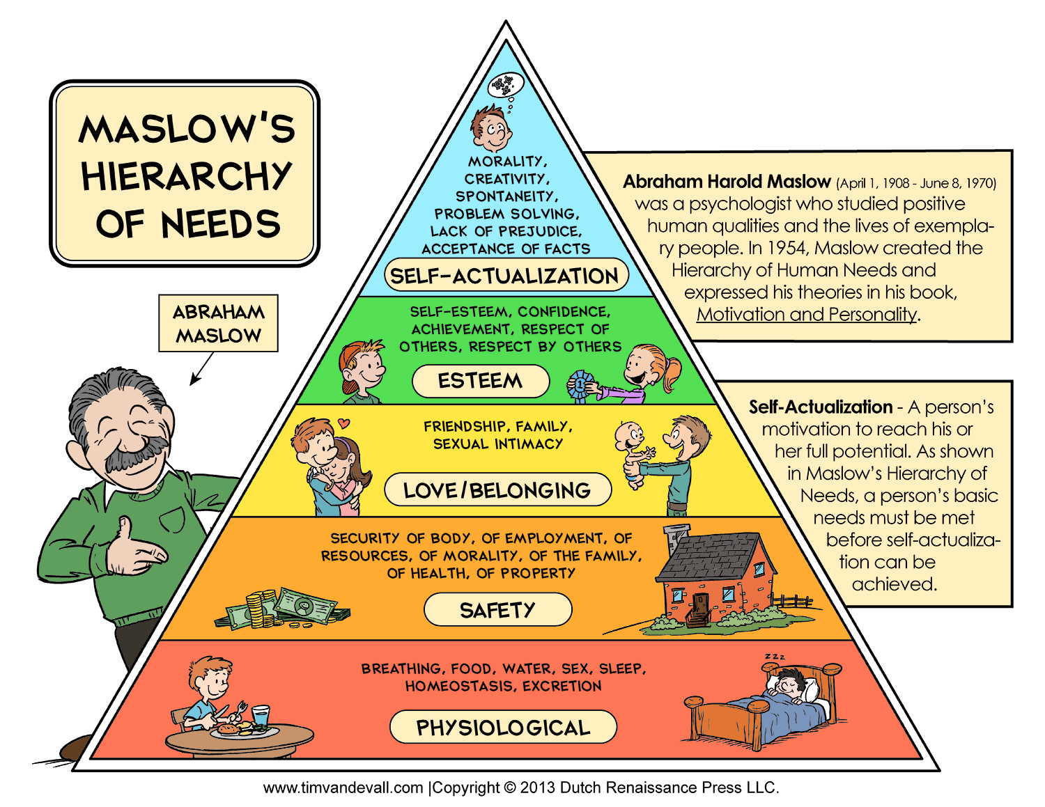
Needs

Slide 6
Eating Terms
Hunger (homeostatic) vs. Appetite (desire)
Energy balance = in vs. out
Baseline body weight = set point (strongly enforced: when you diet your body reduces metabolic rate to preserve the set point!)
Anorexia nervosa: extreme control over eating
Bulimia nervosa: binge and purge
Eating disorders have genetic, cultural influences

Slide 7
Work Motivation
Industrial and Organizational Psychology (I/O)
Traits: stable personality factors – conscientious, honest, lazy, aggressive, sociable, shy, etc..
Workaholic: neuroticism, perfectionism, conscientiousness
Perceived self efficacy: If we are good at something, we reinforce that, it becomes part of our self-image.. CCCC = Control! (competence)
Goal-setting theory: specific and difficult goals are good for motivating employees..

Slide 8
Possibly Non-obvious Results
Providing extrinsic rewards undermines intrinsic motivation!
- e.g., rewarding kids for homework?
Emphasizing trait makes people nervous
- “you’re so smart” vs. “you worked hard!”

Slide 9
Social Motivation
Need to Affiliate: we like to have people around (at parties and speeches, but not at beaches..)
Women affiliate under stress, men do opposite
Need to Belong: positive mutual in-group interactions of an enduring nature: key factor in overall happiness.
Loneliness: not as much belonging as wanted
Intimacy: self-disclosure, partner responsiveness

Slide 10
Aggression
Intended harm to others; others intend to avoid; not necc. violent
Instrumental: some other goal; not to harm
Hostile: purpose is to harm, emotionally driven
Men: more direct aggression; Women: indirect
- testosterone?? Not clear.
GAM: traits, situation, emotion, decisions
- frustration is common trigger, but not always

Slide 11
Defining Terms
Emotion is short lived psychological state that:
Activates specific emotional neural systems
(amygdala, ventral striatum, ventral-medial PFC)
Has characteristic subjective feeling
Triggers physiological changes (heart rate etc)
Also cognitive changes (thinking is altered)
And behavioral responses (behavior is affected)
Mood is long lasting, less intense, not triggered
Affect is simple “map” for categorizing emotions
valence (good / bad)
arousal (high / low)

Slide 12
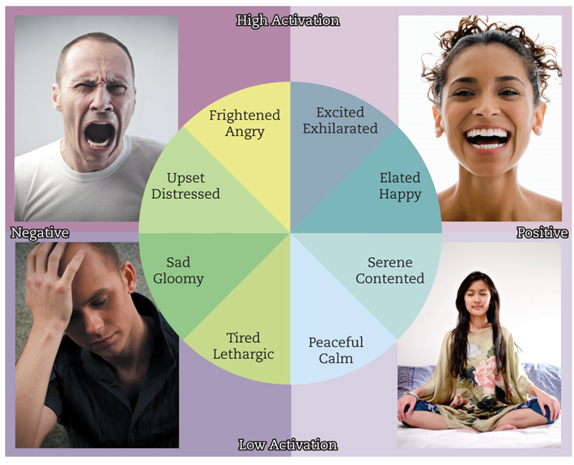
Valence vs. Arousal

Slide 13
Basic Emotions
Fear, Anger, Sadness, Happiness, Disgust, Contempt, Surprise/Interest

Slide 14
The Face of Emotion
These facial expressions are universal.
What are they!?

Slide 15
Emotion for Communication
It is important to communicate emotion – hence facial expressions.. And emoticons :)
Display rules are cultural conventions about when and how to display emotions: intensify, de-intensify, mask, neutralize

Slide 16
Chicken or Egg?
James-Lange: emotion comes from physiological reactions (autonomic nervous system)
Cannon-Bard: no, it is both cognitive and physiological (many diff emotions give rise to same physiological feelings)
Schacter-Singer Two Factor: physiological + cognitive label
Cognitive-motivational-relational: appraisal is key
Facial feedback: facial expression is key

Slide 17
The Two Faces of Happiness
Happiness = instantaneous emotional feeling
Happiness = long-term life satisfaction
Good news: everybody’s happy-ish!
Bad news: some people aren’t!
Parents are low on instantaneous, high on long-term..

Slide 18
Stress Management..
Stress is mostly “in your head” – does all this stuff really matter that much, or perhaps not??
To reduce stress, become a Boulderite:
Exercise
Meditation
Optimism
Sunshine, fresh air, etc..

Slide 19
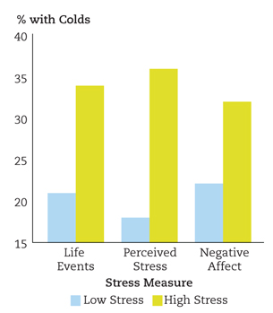
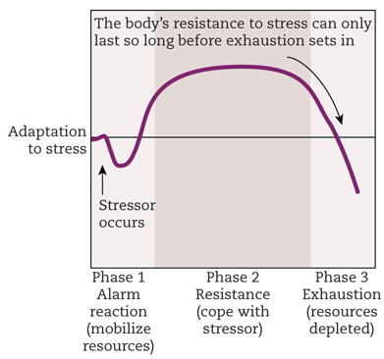
Stress THEN Sick
Stress itself does not make you sick..
It is the depletion period AFTER the stressor is over that makes you sick!

Slide 20
Defining Terms
Personality:
Organized
Integrated
Relatively Enduring
i.e., not just some random stuff you do..

Slide 21
Person-Situation Controversy
Does personality exist at all, or are we just a product of our situations??
Walter Mischel (1960’s): Situation is dominant
Seymour Epstein (1970’s): Need to integrate over multiple situations to see personality traits!
Trait-situation behavior model: both factors together determine behavior (the answer is always both!)
What if our behavior was so consistent that you could see personality in every action? Where is free will!?

Slide 22
The Big Five OCEAN
Openness
imaginative, curious, intellectual, creative.. Vs:
conventional and practical, enjoy routine, “down to earth”
Conscientiousness
careful, thorough, well-organized, responsible Vs:
careless, inefficient, disorganized, irresponsible
Extraversion*
Sociable, energetic, assertive, other-oriented Vs:
Passive, reserved, quiet, self-oriented
Agreeableness
Warm, kind, empathetic, compassionate, trusting Vs:
Hostile suspicious, unkind, lacking in trust..
Neuroticism*
Easily upset, anxious, emotional, self-pitying, worriers.. Vs:
Even-tempered, comfortable with selves, calm, stable.
Notes:
Do clicker quiz of class on each!!!

Slide 23
Genetics and Change
As usual, about 50% contribution of genetics to personality factors (parents know this!)
Traits get more stable over time
Biggest change is in young adulthood (you!)
Rank-order stability: how do their factors rank over time? Measures patterns within individuals. More stable
Mean-level stability: does overall population level of trait change over time? Less stable.

Slide 24
Measurement Techniques
MMPI: Minnesota Multiphasic Personality Inventory: objective (scored by computer)
Low in face validity, but useful for abnormal diagnosis
NEO-PI: high face validity, only useful for normal diagnosis
TAT, Rorschach: highly subjective, not used..
Low validity, low reliability

Slide 25
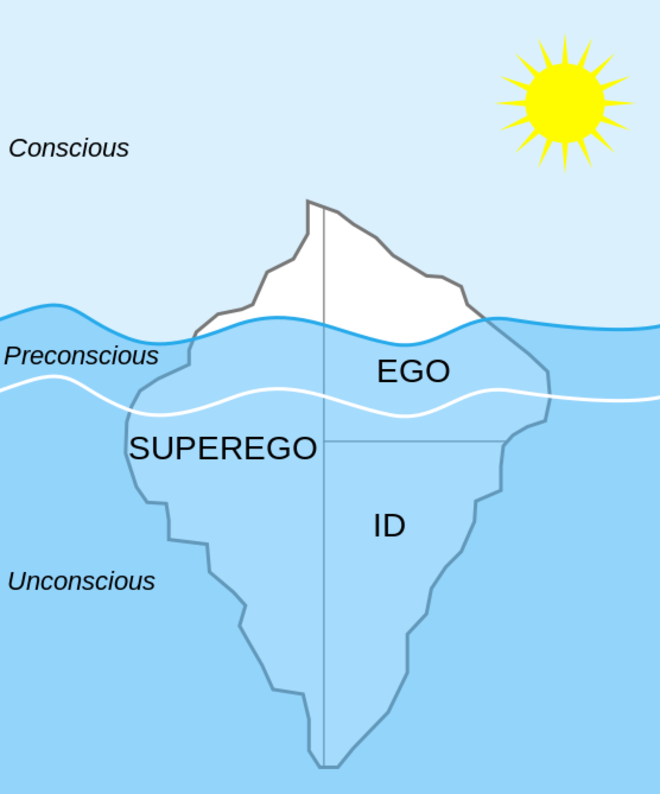
Freud

Slide 26
Definition of a Disorder
Maladaptive: causes impairments, dysfunction
Often distressing to individual / others
Extreme version of “normal”
Edge is always fuzzy.. people go up and down in severity..
Like all categories, disorder categories are fuzzy..
Normal depression -> depression disorder transition happens when it lasts too long, is too debilitating..

Slide 27
DSM-5 Categories: DWasSoft (Diagnostic and Statistical Manual of Mental Disorders)
Substance-Use, Addictive disorders
Schizophrenia, Psychotic disorders
Depressive and Bipolar disorders
Anxiety disorders (GAD, Phobia)
Obsessive-Compulsive disorders (OCD)
Feeding, Eating disorders (Anorexia, Bulimia)
Wake-Sleep disorders (Insomnia, Narcolepsy)
Trauma and Stressor-Related disorders (PTSD)
Notes:
DWasSoft

Slide 28
Bipolar
Manic – depressive phases
Hypomania = lower-level of mania that can produce highly creative work – many famous creative people had bipolar disorder

Slide 29
Anxiety
Generalized anxiety disorder (GAD)
Excessive, difficult to control anxiety and worry
One or more of: restlessness, on edge; difficulty concentrating, going blank; irritability; muscle tension
Panic attack: overwhelming terror (~10 min)
Panic disorder: fear of having attacks -> agorophobia (avoid public, confined places)
vs. Specific phobias (snakes etc)

Slide 30
Triple Vulnerability Theory (Barlow)
Generalized Biological Vulnerability (genetic)
Generalized Psychological Vulnerability
General beliefs about the world (dangerous, etc)
Specific Psychological Vulnerability
Specific learned beliefs / situations (embarrassment is very bad)
= Stress -> Social Anxiety Disorder

Slide 31
Diathesis-Stress Model
Diathesis = genetic vulnerability (50% heritability as usu)
Stress: experience that triggers latent genetic predisposition
Mindfulness-based therapy attempts to reduce stress response to adverse experiences, promote acceptance, understanding.

Slide 32
PTSD
Re-experiencing traumatic event
Negative changes in mood and cognition: detachment, loss of interest..
Changes in physiological arousal levels and reactivity: sleep, irritability, reckless, self-destructive..
1.3% develop in any given year. 6% of 9/11 terror attacks suffered from PTSD. Resilience!

Slide 33
Personality Disorders http://www.tandfonline.com/doi/abs/10.1207/s15327965pli0402_1#.VSzQsxPF9Fs
Extreme versions of “normal” personalities?
Antisocial: ---agreeableness?
Avoidant: +++neuroticism, ---extroversion
Borderline: +++neurotic, ---agreeable, ---conscientious
Paranoid: +++neuroticism
Obsessive-compulsive PD: +++conscientious
Schizoid: ---extroversion
Narcissistic: ---agreeable, ??

Slide 34
DSM Definition of PD
Personality disorder must have at least 2 impairments:
Identity: stable self-esteem, boundaries, etc
Self-direction: ability to pursue goals
Empathy
Intimacy

Slide 35
Therapy Definition
Psychotherapy is a unique form of relationship:
Focus entirely on client’s needs and problems
Therapist is paid
Therapy takes place in structured setting
Each meeting is time-limited (e.g., 50min)
The relationship is expected to terminate

Slide 36
Forms of Therapy
Current, Empirically Supported Therapy (EST):
Cognitive-Behavior Therapy (CBT): change thoughts and behaviors (GAD, Panic, Depression)
Mindfulness-based CT (MBCT): + acceptance
Behavior Therapy (BT): conditioning (Depression)
Exposure Therapy (OCD, phobias)
(also Group, Family, Couple Therapy)
Integrative: most common, tailor to client
Old: Psychoanalysis, Psychodynamic Therapy, Client-Centered Therapy, REBT

Slide 37
Cognitive (Behavior) Therapy
Goal: change negative beliefs, automatic thoughts (negative cognitive triad, Beck) *and behaviors*
Method: get client to question beliefs, confront negative thoughts with positive facts..
Challenges: Many ways of focusing on negative: Overgeneralization; Discounting positives; Catastrophizing; Mind-reading; Magnifying; Filtering

Slide 38
Behaviorism and Exposure
Behavior Therapy: Use operant, classical conditioning to shape positive patterns of behavior (prizes, token economy, contingency mgmt)
Exposure Therapy: Extinguish negative associations through careful extinction training: systematic desensitization (don’t activate “US”)
.. or flooding (wear it down!)

Slide 39
Therapy Works!
Average client is better than 80% of non-clients!
Randomized Controlled Trials: gold standard (random assignment -> causal not just correlation)
Clinical Significance: need more than a statistical effect – need an actual “cure” (e.g., couple therapy example: does couple stay together??) – Not widely achieved!!

Slide 40
Why All Therapies Work (everyone’s a winner! = dodo bird)
Theraputic alliance; Therapist allegiance and competence. (Huh?)
Why do these factors make people feel better?
Hope, confidence, positive emotions, willingness to commit effort..
In other words, therapy imparts self-efficacy and reboots goal-driven cognitive system!
CCCC = Control

Slide 41
Pharmacotherapy
No more effective than “placebo” for most people
Massive conspiracy marketing from drug companies, pushing a “miracle cure” for shiny happy people!
Major side effects and risks, including extreme violence, suicide in some cases..

Slide 42
First: The Self (Cogito Ergo Sum, and CCCC = Control)
The best self-defense is a good offense:
Self-serving bias: overestimate contributions (I really do 75% of housework!), relative status (I’m definitely above average!), attribution errors (success = all me, failure = someone/thing else)
Positive illusions: it’s good to be delusional! uncritically positive views of self, illusions of control, unrealistic optimism: all CCCC=Control!

Slide 43
Control and Dissonance (Must stay in control, always..)
Cognitive Dissonance: when behavior is at odds with beliefs / values / attitudes:
Change: attitudes to match behavior, behavior to match attitudes, or perception of mismatch!
Cannot just let it go.. Must stay in control, always..
Often first or last – behavior is strong – “rationalizing” behavior
e.g., I am on diet; eat cookie anyway; reduce dissonance by minimizing (“only 1!”) or justifying (“I worked hard today”), etc.

Slide 44
Actually Changing Behavior..
Self control: suppressing desires to be a better you, who is less dissonant with beliefs, values
Self regulation: All the processes of monitoring and controlling to achieve goals..
Marshmallow study (Mischel): behavior as a kid predicts many later life outcomes!
Depends on PFC executive function: so does a lot of other stuff (3rd variable: PFC is good, not self ctrl?)
Baumeister and “muscle” theory of control: recent failures to replicate!
False hope syndrome: we are unrealistically optimistic!

Slide 45
Actual Social Psychology
Social Comparision: upward, downward
Both occur; make you feel good / bad about self
Shadenfreude: someone’s downfall is your upfall..

Slide 46
Actual Social Psychology
Attribution theory: why do people do what they do? Is it them (disposition) or the situation?
Fundamental Attribution Error: attribute other’s behavior to them, ignoring situation.
Situation often invisible
But not so reliable cross-culturally, or in real adults..
And situation acts via dispositions in first place!

Slide 47
Actor-Observer Bias
When I cut someone off, I’m just late – when they do it, they’re just rotten jerks (always!)
Mainly happens for negative behaviors that we want to explain away via situation (but don’t have that motivation for others).

Slide 48
Spotlight Effect
You think the whole world’s watching you / but they’re all just watching themselves!
I think this is a huge effect – and hugely important for your own personal well-being
Don’t worry about what others think of you – they’re too busy worrying about themselves!
Golden rule! Relax, be happy, etc.
OTOH, if you’re weird, people will talk about you and generally not want to socialize with you.

Slide 49
Social Attraction
We are attracted to people who are similar to us, but not identical (no inbreeding!) (positive assortment).
And what we’ve been exposed to (mere exposure effect)
And: Symmetry, averageness, exaggerated sex features, age

Slide 50
Group Dynamics: Actual “Social” Behavior!
Conformity: Very strong effect!
but often unrecognized.
Brains wired for social approval
Groupthink: collective failure to consider what could go wrong.. Bay of Pigs, Iraq War..

Slide 51
Selfish Genes and Inclusive Fitness
Genes are selfish: they can live forever – we are just temporary hosts! (The great chain of being: genes passed down over millions of years!)
You share tons of genes with relatives – even distant ones (we are all distant cousins)..
We are motivated to help each other: Altruism = inclusive fitness of the group! Empathy = proximate cause

Slide 52
Stereotyping, Prejudice (major focus of research at CU)
Stereotyping: typical features of given group – erroneously assumed to apply to all members of group. CCCC = Compression / Categorize
Prejudice: pre-judging according to stereotypes
often implicit (IAT):

